Slide 1
Recursion
Recursive Algorithms and Backtracking

Slide 2
Table of Contents
What is Recursion?
Recursive Factorial
Backtracking
The 8 Queens Problem
Finding All Paths in a Labyrinth Recursively
Recursion or Iteration?
Harmful Recursion and Optimizing Bad Recursion

Slide 3
The Stack
The stack is a small fixed-size chunk of memory (e.g. 1MB)
Keeps the currently called functions in a stack data structure
Changes as the program enters / exits a function
When Print returns it gets popped from the stack
static void Main()
{
Print("Hello");
}
Print()
Main()
When Print is called it is pushed onto the stack
Stack

Slide 4
What is Recursion?

Slide 5
What is Recursion?
Recursion is when a method calls itself
Powerful technique for combinatorial and branched search algorithms design
Recursion should have:
Direct or indirect recursive call
The method calls itself directly
Оr through other methods
Exit criteria (bottom)
Prevents infinite recursion

Slide 6
Recursive Factorial – Example
Recursive definition of n! (n factorial):
n! = n * (n–1)! for n > 0
0! = 1
5! = 5 * 4! = 5 * 4 * 3 * 2 * 1 * 1 = 120
4! = 4 * 3! = 4 * 3 * 2 * 1 * 1 = 24
3! = 3 * 2! = 3 * 2 * 1 * 1 = 6
2! = 2 * 1! = 2 * 1 * 1 = 2
1! = 1 * 0! = 1 * 1 = 1
0! = 1

Slide 7
Recursive Factorial – Example
Calculating factorial:
0! = 1
n! = n* (n-1)!, n>0
static decimal Factorial(int num) { if (num == 0)
return 1; else
return num * Factorial(num - 1); }
The bottom of the recursion
Recursive call: the method calls itself

Slide 8
Recursive Factorial
Demo

Slide 9

Recursive Array Sum
sum
10 | 3 | 7 | 3 | 4
27
In-Class Exercise (Lab)

Slide 10
Performance: Recursion vs. Iteration
Recursive calls are slightly slower than iteration
Parameters and return values travel through the stack at each step
Prefer iteration for linear calculations (without branched calls)
Recursive factorial:
Iterative factorial:
static long RecurFact(int n) { if (n == 0)
return 1; else
return n * Fact(n - 1); }
static long IterFact(int num) { long result = 1;
for (int i = 1; i <= n; i++)
result *= i;
return result; }

Slide 11

Infinite Recursion
Infinite recursion == a method calls itself infinitely
Typically, infinite recursion == bug in the program
The bottom of the recursion is missing or wrong
In C# / Java / C++ causes "stack overflow" error
static long Calulate(int n)
{
return Calulate(n + 1);
}

Slide 12
Direct and Indirect Recursion
void A() {
…
A();
}
Direct recursion
A method directly calls itself
Indirect recursion
Method A calls B, method B calls A
Or even A → B → C → A
void A() {
…
B();
}
void B() {
…
A();
}

Slide 13
Recursion Pre-Actions and Post-Actions
Recursive methods have 3 parts:
Pre-actions (before calling the recursion)
Recursive calls (step-in)
Post-actions (after returning from recursion)
Recursive computation can be based on:
Pre-actions + recursive calls (forward way)
Recursive calls + post-actions (backward way)
Pre-actions + recursive calls + post-actions (combined way)

Slide 14
Pre-Actions and Post-Actions – Example
static void PrintFigure(int n)
{
if (n == 0) // Bottom of the recursion
return;
// Pre-action: print n asterisks
Console.WriteLine(new string('*', n));
// Recursive call: print figure of size n-1
PrintFigure(n - 1);
// Post-action: print n hashtags
Console.WriteLine(new string('#', n));
}

Slide 15
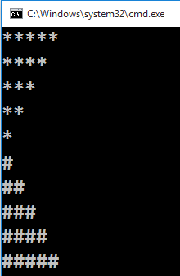
Pre-Actions and Post-Actions
Live Demo

Slide 16
Generating Combinations
Simple Recursive Algorithm

Slide 17
Generating Combinations
Combinations in math represent all the ways to extract a subset from a larger set of elements
Select k members from a set of n elements
Example: we can select 3 different elements from the set {4, 5, 6, 7, 8} in 10 different ways:
(4, 5, 6) (4, 5, 7) (4, 5, 8) (4, 6, 7) (4, 6, 8)
(4, 7, 8) (5, 6, 7) (5, 6, 8) (5, 7, 8) (6, 7, 8)
Combinations with and without repetitions can be easily generated with recursion

Slide 18
Generating Combinations (2)
Algorithm GenCombs(k): put the numbers [1 … n] at position k and call GenCombs(k+1) recursively for the rest of the elements:
GenCombs(0):
GenCombs(1):
GenCombs(n):
Print;
Stop!
1 | x | x | x | x | x | x
→
1 | 1 | x | x | x | x | x
…
GenCombs(1)
GenCombs(2)
Put all numbers in range [1..n] at position k
Put all numbers in range [1..n] at position k
Bottom of recursion

Slide 19
Generating Combinations (3)
static void GenCombs(
int[] arr, int index, int startNum, int endNum)
{
if (index >= arr.Length) // Combination found --> print it
Console.WriteLine("(" + String.Join(", ", arr) + ")");
else
for (int i = startNum; i <= endNum; i++)
{
arr[index] = i;
GenCombs(arr, index + 1,
i + 1, endNum);
}
}
static void Main()
{
int[] arr = new int[3];
GenCombs(arr, 0, 4, 8);
}

Slide 20
Backtracking
Solving Computational Problems by Generating All Candidates

Slide 21
Backtracking
What is backtracking?
Backtracking is a class of algorithms for finding all solutions to some combinatorial computational problem
E.g. find all paths from Sofia to Varna
How does backtracking work?
At each step tries all perspective possibilities recursively
Drop all non-perspective possibilities as early as possible
Backtracking has exponential running time!

Slide 22
Backtracking Algorithm (Pseudocode)
void Backtracking(Node node)
{
if (node is solution)
PrintSolution(node);
else
for each child c of node
if (c is perspective candidate)
{
MarkPositionVisited(c);
Backtracking(c);
UnmarkPositionVisited(c);
}
}

Slide 23
The "8 Queens" Puzzle
Backtracking in Practice

Slide 24
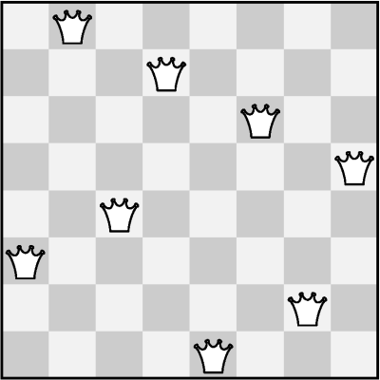
The "8 Queens" Puzzle
Write a program to find all possible placements of
8 queens on a chessboard
So that no two queens can attack each other
http://en.wikipedia.org/wiki/Eight_queens_puzzle

Slide 25
Solving The "8 Queens" Puzzle
Backtracking algorithm
For finding all solutions to the "8 Queens Puzzle"
At each step:
Put a queen at free position
Recursive call
Remove the queen
void PutQueens(row)
{
if (row == 8)
PrintSolution();
else
for (col = 0 … 7)
if (CanPlaceQueen(row, col))
{
MarkAllAttackedPositions(row, col);
PutQueens(row + 1);
UnmarkAllAttackedPositions(row, col);
}
}

Slide 26
The "8 Queens" Puzzle
In-Class Exercise (Lab)

Slide 27
Finding All Paths in a Labyrinth
We are given a labyrinth
Represented as matrix of cells of size M x N
Empty cells are passable, the others (*) are not
We start from the top left corner and can move in all 4 directions: left, right, up, down
We want to find all paths to the bottom right corner
 |  |  | *
* | * |  | * |  | *
 | * | * | * | * | *
Start position
End position

Slide 28
Finding All Paths in a Labyrinth (2)
There are 3 different paths from the top left corner to the bottom right corner:
0 | 1 | 2 | *
* | * | 3 | * |  | *
6 | 5 | 4
7 | * | * | * | * | *
8 | 9 | 10 | 11 | 12 | 13 | 14
0 | 1 | 2 | * | 8 | 9 | 10
* | * | 3 | * | 7 | * | 11
 |  | 4 | 5 | 6 |  | 12
 | * | * | * | * | * | 13
 |  |  |  |  |  | 14
0 | 1 | 2 | *
* | * | 3 | * |  | *
 |  | 4 | 5 | 6 | 7 | 8
 | * | * | * | * | * | 9
 |  |  |  |  |  | 10
1)
2)
3)

Slide 29
Finding All Paths in a Labyrinth (3)
Suppose we have an algorithm FindExit(x,y) that finds and prints all paths to the exit (bottom right corner) starting from position (x,y)
If (x,y) is not passable, no paths are found
If (x,y) is already visited, no paths are found
Otherwise:
Mark position (x,y) as visited (to avoid cycles)
Find recursively all paths to the exit from all neighbor cells: (x-1,y) , (x+1,y) , (x,y+1) , (x,y-1)
Mark position (x,y) as free (can be visited again)

Slide 30
Find All Paths: Algorithm
Representing the labyrinth as matrix of characters (in this example 5 rows and 7 columns):
Spaces (' ') are passable cells
Asterisks ('*') are not passable
The symbol 'e' is the exit (can occur multiple times)
static char[,] lab =
{
{' ', ' ', ' ', '*', ' ', ' ', ' '},
{'*', '*', ' ', '*', ' ', '*', ' '},
{' ', ' ', ' ', ' ', ' ', ' ', ' '},
{' ', '*', '*', '*', '*', '*', ' '},
{' ', ' ', ' ', ' ', ' ', ' ', 'е'},
};

Slide 31
Find All Paths: Algorithm (2)
static void FindExit(int row, int col)
{
if ((col < 0) || (row < 0) || (col >= lab.GetLength(1))
|| (row >= lab.GetLength(0)))
{
// We are out of the labyrinth -> can't find a path
return;
}
// Check if we have found the exit
if (lab[row, col] == 'е')
{
Console.WriteLine("Found the exit!");
}
if (lab[row, col] != ' ')
{
// The current cell is not free -> can't find a path
return;
}
(example continues)

Slide 32
Find All Paths: Algorithm (3)
// Temporaryly mark the current cell as visited
lab[row, col] = 's';
// Invoke recursion to explore all possible directions
FindExit(row, col - 1); // left
FindExit(row - 1, col); // up
FindExit(row, col + 1); // right
FindExit(row + 1, col); // down
// Mark back the current cell as free
lab[row, col] = ' ';
}
static void Main()
{
FindExit(0, 0);
}

Slide 33
Find All Paths and Print Them
How to print all paths found by our recursive algorithm?
Each move's direction can be stored in a list
Need to pass the movement direction at each recursive call (L, R, U, or D)
At the start of each recursive call the current direction is appended to the list
At the end of each recursive call the last direction is removed from the list
static List<char> path = new List<char>();

Slide 34
Find All Paths and Print Them (2)
static void FindPathToExit(int row, int col, char direction)
{
...
// Append the current direction to the path
path.Add(direction);
if (lab[row, col] == 'е')
{
// The exit is found -> print the current path
}
...
// Recursively explore all possible directions
FindPathToExit(row, col - 1, 'L'); // left
FindPathToExit(row - 1, col, 'U'); // up
FindPathToExit(row, col + 1, 'R'); // right
FindPathToExit(row + 1, col, 'D'); // down
...
// Remove the last direction from the path
path.RemoveAt(path.Count - 1);
}

Slide 35
Recursion or Iteration?
When to Use and When to Avoid Recursion?

Slide 36
Recursion Can be Harmful!
When used incorrectly recursion could take too much memory and computing power
Example:
static decimal Fibonacci(int n)
{
if ((n == 1) || (n == 2))
return 1;
else
return Fibonacci(n - 1) + Fibonacci(n - 2);
}
static void Main()
{
Console.WriteLine(Fibonacci(10)); // 89
Console.WriteLine(Fibonacci(50)); // This will hang!
}

Slide 37
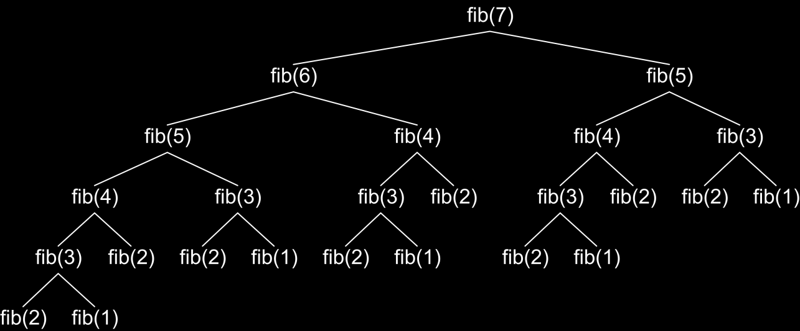
How the Recursive Fibonacci Calculation Works?
fib(n) makes about fib(n) recursive calls
The same value is calculated many, many times!

Slide 38
Fast Recursive Fibonacci
Each Fibonacci sequence member
Can be remembered once it is calculated
Can be returned directly when needed again
static decimal[] fib = new decimal[MAX_FIB];
static decimal Fib(int n)
{
if (fib[n] == 0)
{
// fib[n] is still not calculated
if ((n == 1) || (n == 2))
fib[n] = 1;
else
fib[n] = Fib(n - 1) + Fib(n - 2);
}
return fib[n];
}

Slide 39
When to Use Recursion?
Avoid recursion when an obvious iterative algorithm exists
Examples: factorial, Fibonacci numbers
Use recursion for combinatorial algorithms where
At each step you need to recursively explore more than one possible continuation
I.e. for branched recursive algorithms
Examples: permutations, all paths in a labyrinth
If you have only one recursive call in the body of a recursive method, it can directly become iterative (like calculating factorial)

Slide 40
Summary
Recursion means to call a method from itself
It should always have a bottom at which the recursive calls stop
Very powerful technique for implementing combinatorial algorithms
Examples: generating combinatorial configurations like vectors, permutations, combinations, variations, etc.
Backtracking finds all solutions / optimal solution of combinatorial problem by generating all possibilities
Without non-perspective candidates
Recursion can be harmful when not used correctly

Slide 41
Resources
http://www.introprogramming.info/english-intro-csharp-book/read-online/chapter-10-recursion/
https://www.codeproject.com/Articles/142292/Recursive-methods-in-Csharp
https://code-maze.com/csharp-basics-recursion/
https://www.codeproject.com/Articles/142292/Recursive-methods-in-Csharp

